Slide 1
Depth Peeling
Tutorial

Slide 2
Z-buffer (Depth buffer)
OpenGL stores depth values in buffer called Z-buffer
Allows to decide whether to draw over a pixel or not.
Depth buffer – just like color buffer that store fragment data
Store the depth values within each fragment

Slide 3
Z-buffer (Depth buffer)

Slide 4
Depth testing
glEnable and glDisable
glEnable(GL_DEPTH_TEST);
glClear(GL_COLOR_BUFFER_BIT | GL_DEPTH_BUFFER_BIT);

Slide 5
Transparency problem (non-refractive)
Alpha channel gives a way but not perfect solution
Order Dependency

Slide 6
Shadow Mapping
Depth testing from the light’s point-of-view
Two pass algorithm
First, render depth buffer from the light’s point-of- view
the result is a “depth map” or “shadow map”
essentially a 2D function indicating the depth of the closest pixels to the light
This depth map is used in the second pass
https://www.slideshare.net/Mark_Kilgard/shadow-mappingwith-todays-opengl-hardware

Slide 7
Shadow Mapping
Shadow determination with the depth map
Second, render scene from the eye’s point-of-view
For each rasterized fragment
determine fragment’s XYZ position relative to the light
this light position should be setup to match the frustum used to create the depth map
compare the depth value at light position XY in the depth map to fragment’s light position Z
https://www.slideshare.net/Mark_Kilgard/shadow-mappingwith-todays-opengl-hardware

Slide 8
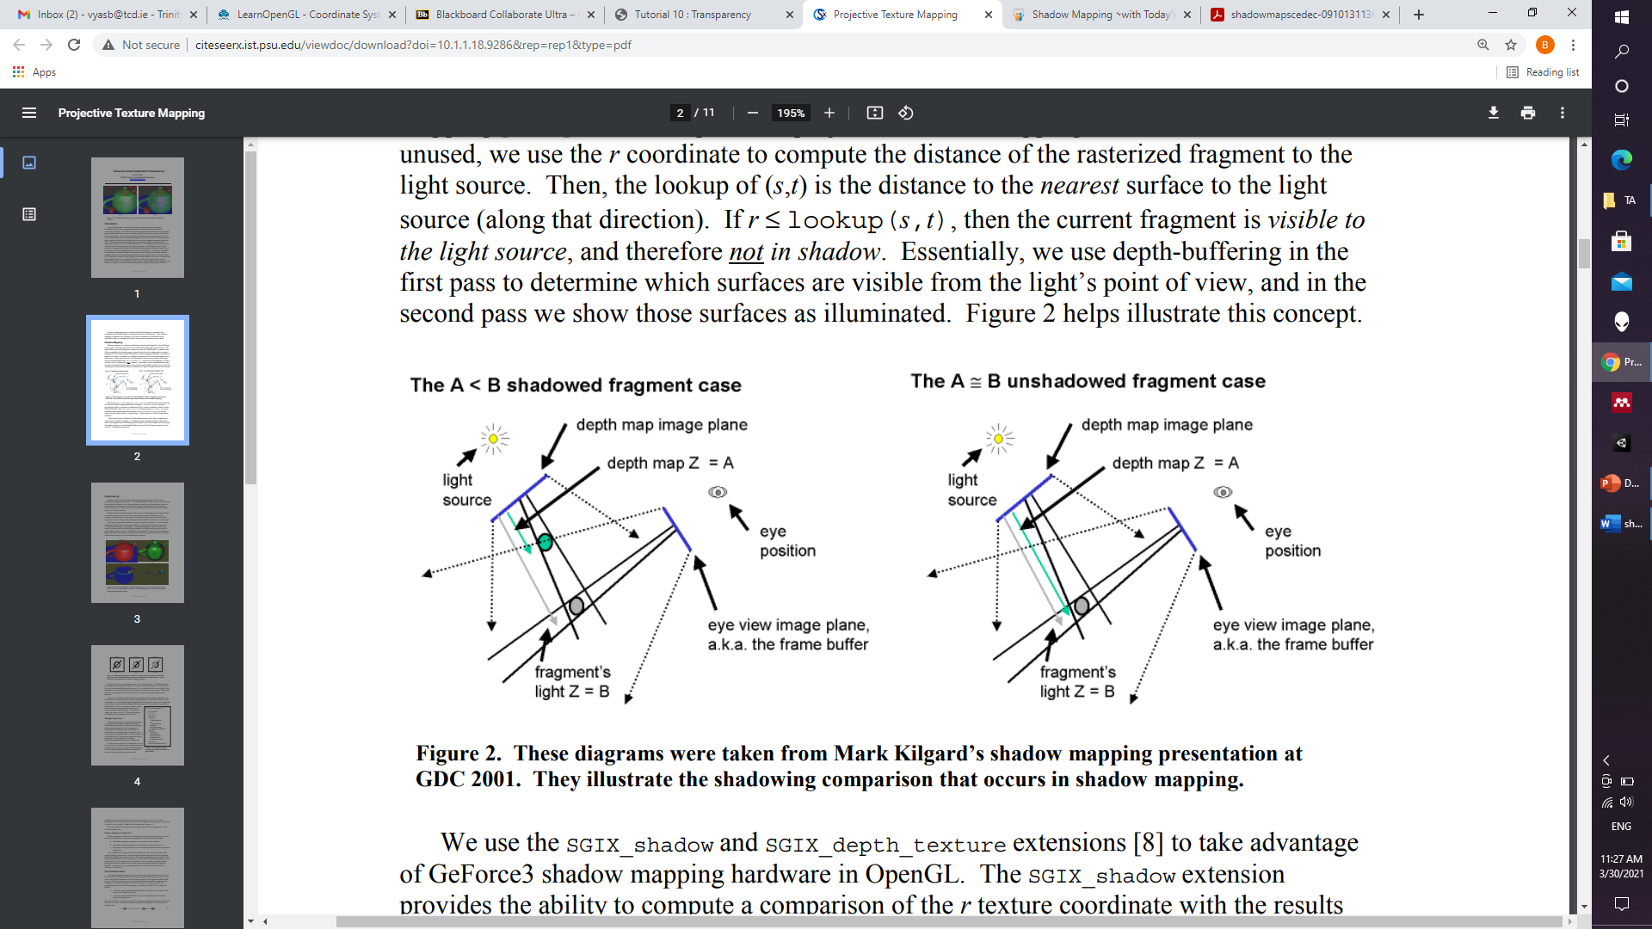
https://www.slideshare.net/Mark_Kilgard/shadow-mappingwith-todays-opengl-hardware

Slide 9
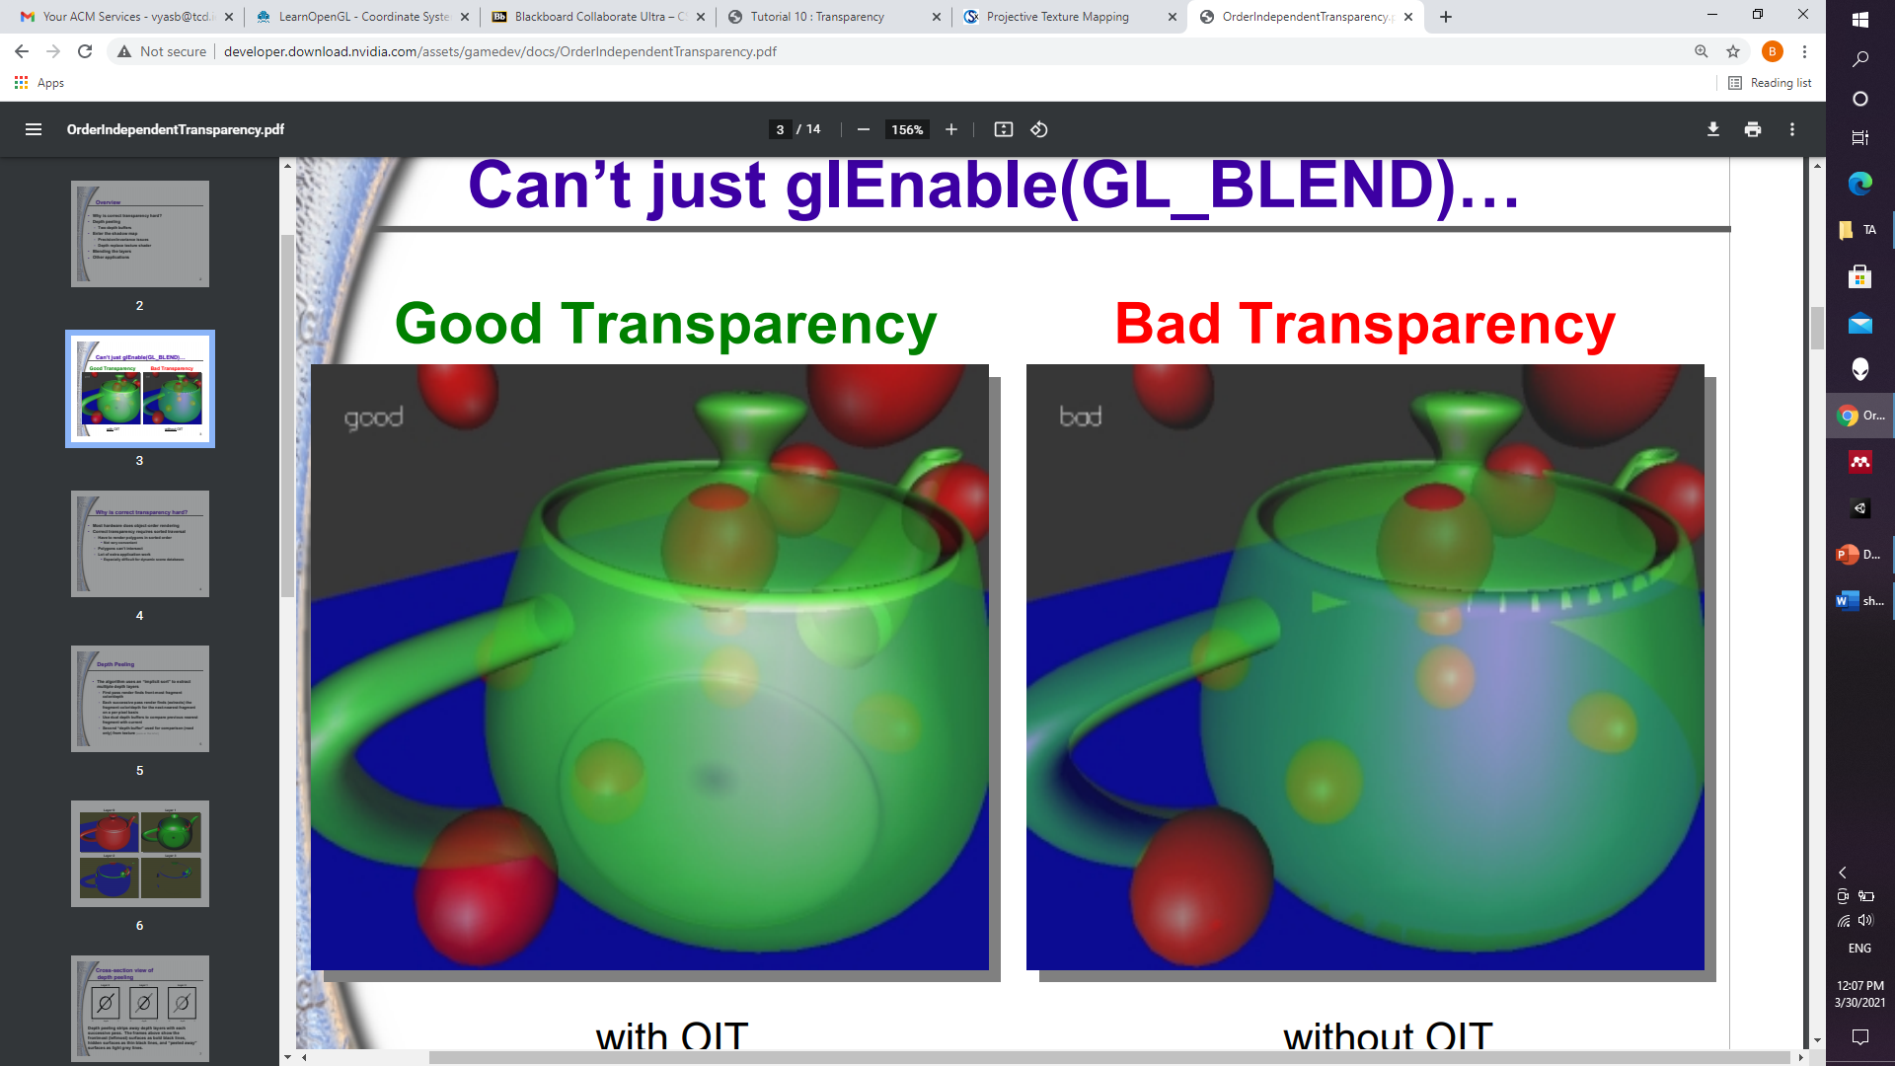
Depth Peeling
Everitt C. Interactive order-independent transparency. White paper, nVIDIA. 2001 May 15;2(6):7.

Slide 10
Depth Peeling
The algorithm uses an “implicit sort” to extract multiple depth layers
First pass render finds front-most fragment color/depth
Each successive pass render finds (extracts) the fragment color/depth for the next-nearest fragment on a per pixel basis
Everitt C. Interactive order-independent transparency. White paper, nVIDIA. 2001 May 15;2(6):7.

Slide 11

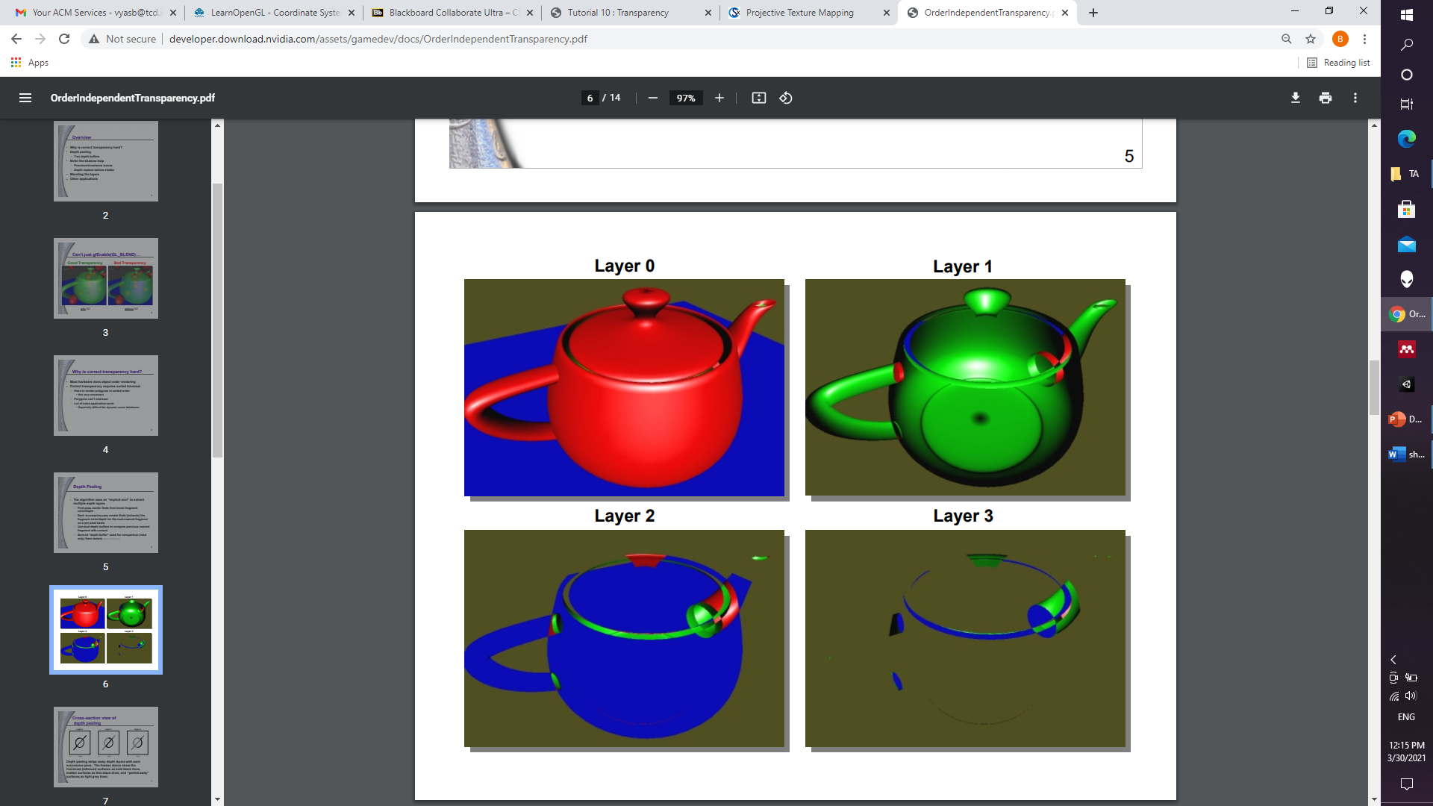
Everitt C. Interactive order-independent transparency. White paper, nVIDIA. 2001 May 15;2(6):7.

Slide 12
Implementation
Need dual depth buffers to compare previous nearest fragment with current
Shadow mapping is used as read only depth test
A fast method to compare the values without need for any correction output
Everitt C. Interactive order-independent transparency. White paper, nVIDIA. 2001 May 15;2(6):7.

Slide 13
Compositing
Each time we peel, we capture the RGBA, then as a final step, we blend all the layers together from back to front.
Opaque fragments completely overwrite previous transparent ones
Peel from back to front and start with all fully opaque objects which require fewer layers.
Correct transparency without invasive changes to internal data structures
Everitt C. Interactive order-independent transparency. White paper, nVIDIA. 2001 May 15;2(6):7.

Slide 14
THANK YOU!

